Slide 1
Lab 1 - MapReduce
2021/04/28

Slide 2
Contents
1
Introduction
2
Getting Start
3
What needs to be done

Slide 3
Introduction

Slide 4
Introduction
What is MapReduce?
A parallel computing model proposed by Google in the paper: MapReduce: Simplified Data Processing on Large Clusters
Notes:
分布式场景下的一种计算模型, 或者说是编程范式.

Slide 5
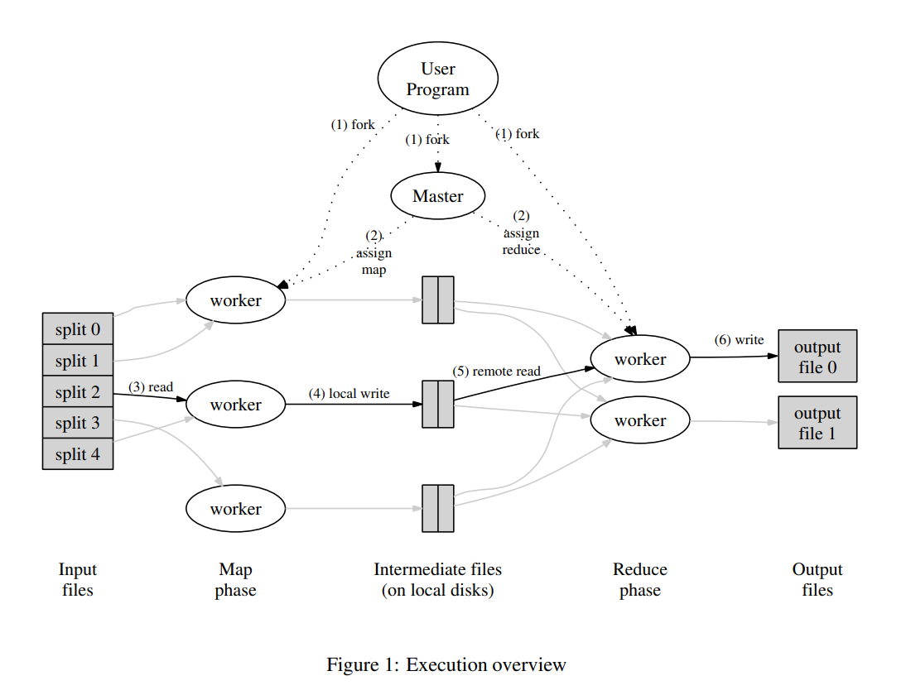
MapReduce

Slide 6
Lab Outline
This lab comes from MIT 6.824, which includes 5 parts:
Part I: Map/Reduce input and output
Part II: Single-worker work count
Part III: Distributing MapReduce tasks
Part IV: Handling worker failures
Part V (Optional and bonus): Inverted index generation
Each part has corresponding test script to test whether your implementation is correct.

Slide 7
Environment Settings

Slide 8
Environment
Platform: Linux
Programming language: Go
Recommend to install Go1.9
I have made tests on MacOS with Go1.15 and Ubuntu16 with Go1.9, both of them are OK.
Git
We will assign labs by Github Classroom in this course.
You need Git to get the source code and submit your handin(including source code and report).
If you know little about Git, please ask google for help.

Slide 9
Environment
If you use Windows, you can:
Install an virtual machine, or
Install WSL, or
Buy Cloud Servers, such as SJTU Cloud.
As for IDE, you can choose the one you like. Such as:
VS Code + Go Plugin
IDEA + Go Plugin
JetBrains GoLand: Capable and Ergonomic Go IDE
Vim/Emacs + Terminal
If there are any problems you can’t fix, you can contact me (see the last slide).

Slide 10
Getting Start

Slide 11
Getting Start (1)
We will complete this lab based on GitHub and GitHub Classroom.
IMPORTANT Apply for a GitHub account.
Then click the link: https://classroom.github.com/a/HCPfO5e2

Slide 12
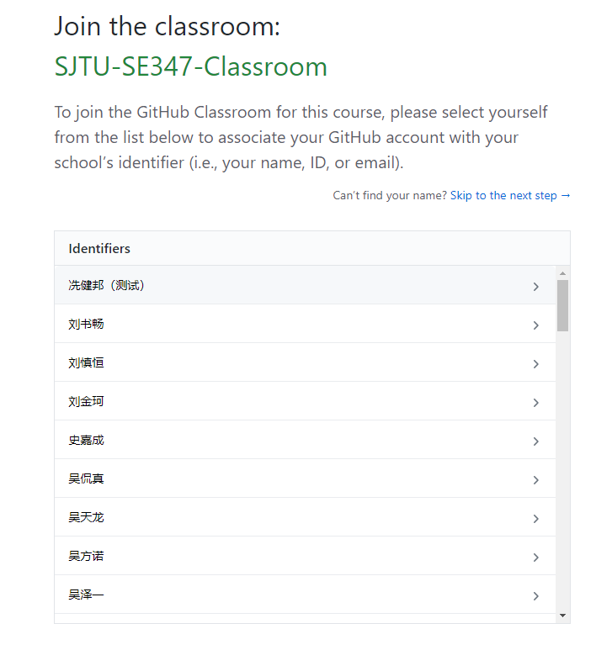
Getting Start(2)
And you will see ...
Just choose your name

Slide 13
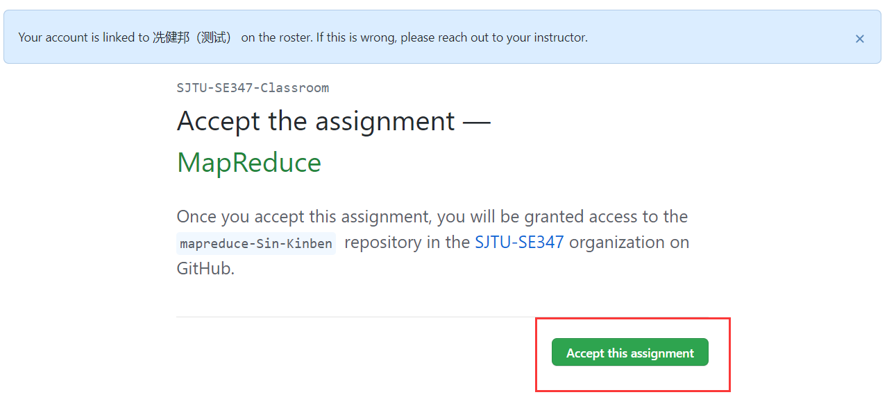
Getting Start(3)
Then accept our assignment MapReduce

Slide 14
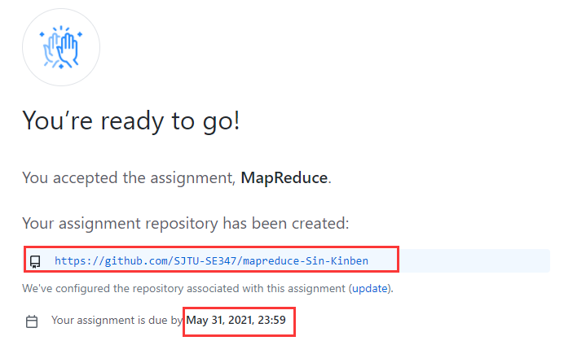
Getting Start (4)
And you will see ...
The link is your own private repository. (Please remember it!)

Slide 15
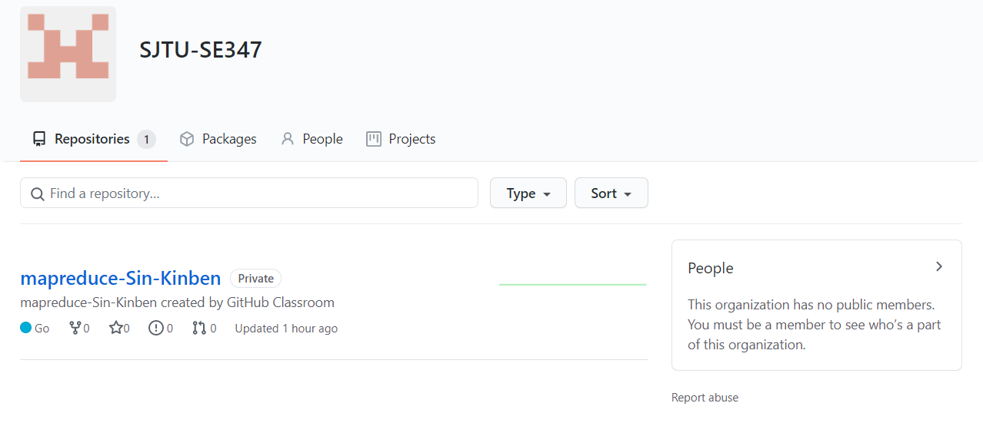
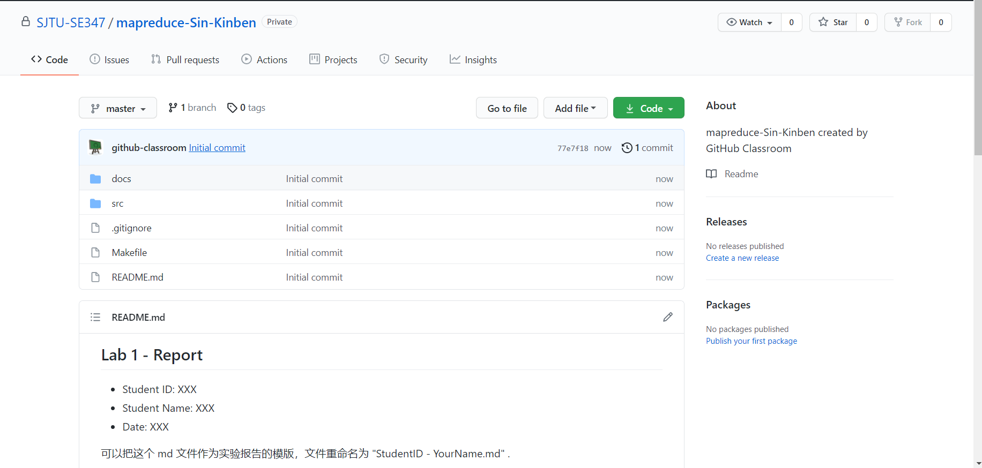
Getting Start (5)
Click your repo’s link, you will see the source code and docs of this lab.
Clone this repo, and start coding!
If you forget the link, come here: https://github.com/SJTU-SE347

Slide 16
What needs to be done

Slide 17
What needs to be done
IMPORTANT Get the source code. (See Getting Start)
IMPORTANT Read the paper: MapReduce (especially Chapter 1 - 3).
IMPORTANT Read the lab description doc: Lab1 - MapReduce.pdf
The description docs is in docs/Lab1 - MapReduce.pdf, see the repo.
IMPORTANT Write your code and report.
IMPORTANT Use Git to push them to the remote repository before the deadline 2021/5/31 23:59.
Start it as soon as possible!

Slide 18
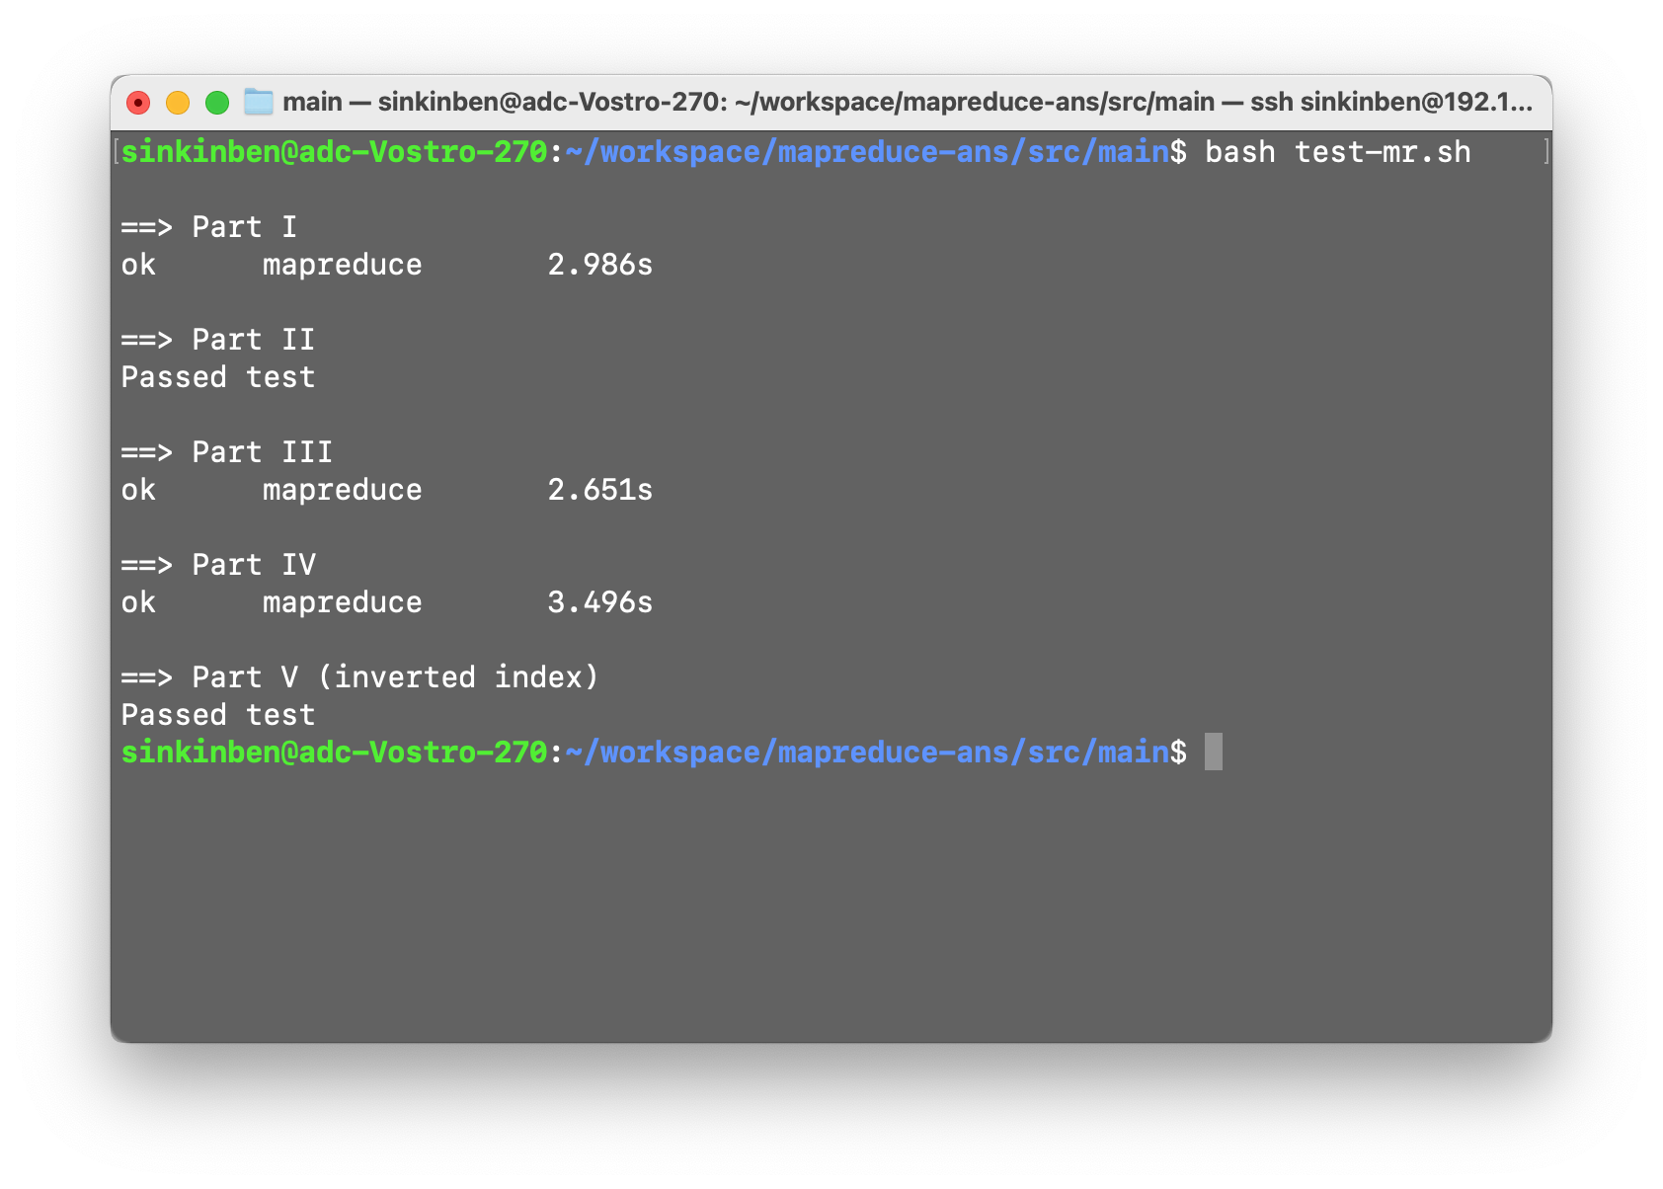
Testing
cd src/main/ && bash test-mr.sh

Slide 19
Notices
The description docs is in docs/Lab1 - MapReduce.pdf
You MUST push your code and report to the remote repository before the deadline.
Some modules (such as src/raft/) don't need to be cared about, they are irrelevant with MapReduce. (If you want to know more, you can visit the homepage of MIT6.824.)
You only need to care about the modules mentioned in the document.
More details are in the docs/Lab-1 MapReduce.pdf, please read the doc carefully!

Slide 20
Learning Material
Git Guide: https://github.com/git-guides/
Go: https://golang.google.cn/doc/

Slide 21
Contact
If your have any problems, welcome to contact me.
Email: sinkinben@outlook.com
WeChat: sinkinben
Location: 软件学院 5318

Slide 22
Q&A

